Slide 1


HOW A.I. CAN HELP TO COMBAT CYBER BULLYING
A PROJECT REPORT
for
ARTIFICIAL INTELLIGENCE (ITE2010)
in
B.Tech. (IT)
by
Ansh Gupta (19BIT0220)
6th Sem, 3rd Year
Under the Guidance of
Prof. CHIRANJI LAL CHOWDHARY
Associate Professor, SITE
School of Information Technology and Engineering
May-June, 2022

Slide 2



VERY PERI
Cyberbullying is the use of internet and related technologies to harm other people in a deliberate, repeated and hostile manner.
Introducing the Pantone Colour of the Year 2022. PANTONE 17-3938 Very Peri is a dynamic hue that blends the faithfulness and constancy of blue with the energy and excitement of red.
The four colour palettes in this template feature Very Peri to help you express your ideas and convey the right mood. Read on to learn how to use these colours in any presentation.
Abusive texts and emails
Hurtful messages , images and videos
Imitating others online to set them up
Excluding others online
Nasty online gossip and chat
WHAT IS CYBERBULLYING
This Photo by Unknown Author is licensed under CC BY-NC-ND
This Photo by Unknown Author is licensed under CC BY-NC-ND
This Photo by Unknown Author is licensed under CC BY-ND

Slide 3
1 in 3 young people have experienced cyber threats online
1 in 4 young people have been bullied through their mobile phones
Over the half of young people do not tell their parents when cyberbullying occurs
Over half of adolescents and teens have been bullied online and about the same number engaged in it
2 in 3 teens who have witnessed online cruelty have also witnessed other joining
Fewer than 1 in 5 cyber bullying incidents are reported to law enforcement
Stats – WHO & HOW

Slide 4
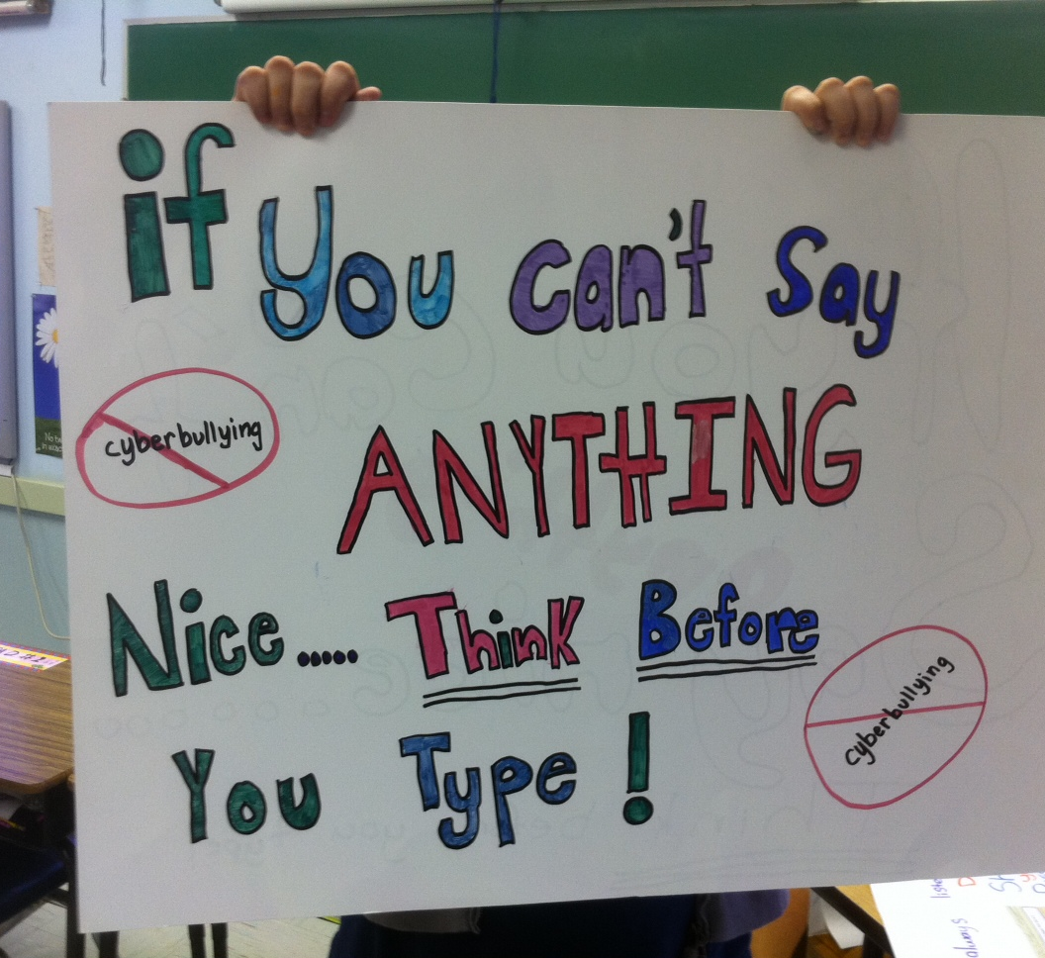
Automatically detecting cyberbullying in social media
This Photo by Unknown Author is licensed under CC BY-SA-NC

Slide 5
Synopsis and through synopsis what all we are going to do in my project
With the help of NLP and machine learning algorithms such as naive bayes, random forest, SVM we are going to identify cyberbullying in social media platforms such as twitter, facebook etc.
With the help of OCR we are going to find image based cyberbullying and also the impact on individual basis.
Machine learning and natural language processing techniques we use to identify the characteristics of a cyberbullying exchange and automatically detect cyberbullying by matching textual data to the identified traits.

Slide 6
Supervised learning
Lexicon-based
Rule-based
Mixed-initiative
Categorise all the approaches into 4 main classes

Slide 7
Supervised learning-based approaches typically use classifiers such as SVM and Naive Bayes to develop predictive models for cyberbullying detection.
Lexicon-based systems utilise the word lists and use the presence of words within the lists to detect cyberbullying.
Rule-based approaches match text to predefined rules to identify bullying, and mixed-initiatives approaches combine human-based reasoning with one or more of the aforementioned approaches.

Slide 8
LITERATURE SURVEY
DISADVANTAGE
TITLE | AUTHOR | PROBLEM | SOLUTION | ADVANTAGE
Automatic detection of cyberbullying in social media text | Cynthia Van Hee,Gilles Jacobs,Chris Emmery,Bart Desmet | Increased the cyberbullying using Social media sides/apps. | The focus of this paper is on automatic cyberbullying detection in social media text by modelling posts written by bullies, victims, and bystanders of online bullying. In this paper support vector machine is used to exploiting a rich feature set and investigate which information sources contribute the most for the task. | In this paper investigate the automatic detection of cyberbullying-related posts on social media. Given the information overload on the web, manual monitoring for cyberbullying has become unfeasible. | Automatic detection of signals of cyberbullying would enhance moderation and would not allow to respond quickly when necessary.
Cyberbullying Detection System on Twitter | Liew Choong Hon, Kasturi Dewi Varathan | Increased cyberbullying attacks on the social network services. To prevent these activities proposed an system. | The users can identify the cyberbullying related tweets based on the keywords and populate it in a news feed form. By doing this, it allows users to determine the identities of the cyberbullies and the victims from the cyberbullying tweets | With the advent of this cyberbullying detection and solution system in Twitter, it will help the authorities to monitor, regulate or at least decrease the harassing incidents in cyberspace
Through the techniques used in this paper there is least decrease the harassing incidents in cyberspace.

Slide 9
Methods for detection of cyberbullying: A survey | Rekha Sugandhi, Anurag Pande, Siddhant Chawla, Abhishek Agrawal, Husen Bhagat | Major problem when it comes to cyber bullying is the lack of identifiable parameters which mark any post as a bullying instance. | This paper aims to review the different methods and algorithms used for detection in cyber bullying and provide a comparative study amongst them so as to decide which method is the most effective approach and provides the best accuracy. | In this paper realize support vector machines have given the best result.
An Effective Approach for Cyberbullying Detection and avoidance | Divyashree, Vinutha H, Deepashree N S | The biggest problem regarding cyberbullying is that the age group of the offenders ranges from as young as eight to the legal adult age of eighteen and beyond. Once happen this activity then victims are often left permanently then difficult to find them. | In this paper focused on the issues of robust system and objectives are 1) Automatic detection and avoidance of cyberbully attack in internet. 2) Effective age authentication for website browsing and categorizing the links based on age. 3) Effective website filtering in search results based on ranking. 4) Enhanced searching procedure promisingly reduces the effort of user in searching indented websites. | Represented a novel method on the current scenario of cyber-bullying and various methods available for the detection and prevention of cyber harassment.
Using Machine Learning to Detect Cyberbullying | Kelly Reynolds, April Kontostathis, Lynne Edwards | Teens and young adults, are finding new ways to bully one another over the Internet. in a study conducted by Symantec reported that, to their knowledge, their child has been involved in a cyberbullying incident. | Used machine learning algorithm to detect cyberbullying. For training the data downloaded from website. | Used a language-based method of detecting cyberbullying. By recording the percentage of curse and insult words within a post.
They have not plan to implement SVM in their project as the primary classifier for our base dataset.
Their concept depends upon the text analysis, the data which is uploaded or text written by any user is first analyzed.
The data was labeled using a web service. the labeled data, in conjunction with machine learning techniques provided by the Weka tool kit, to train a computer to recognize bullying content

Slide 10
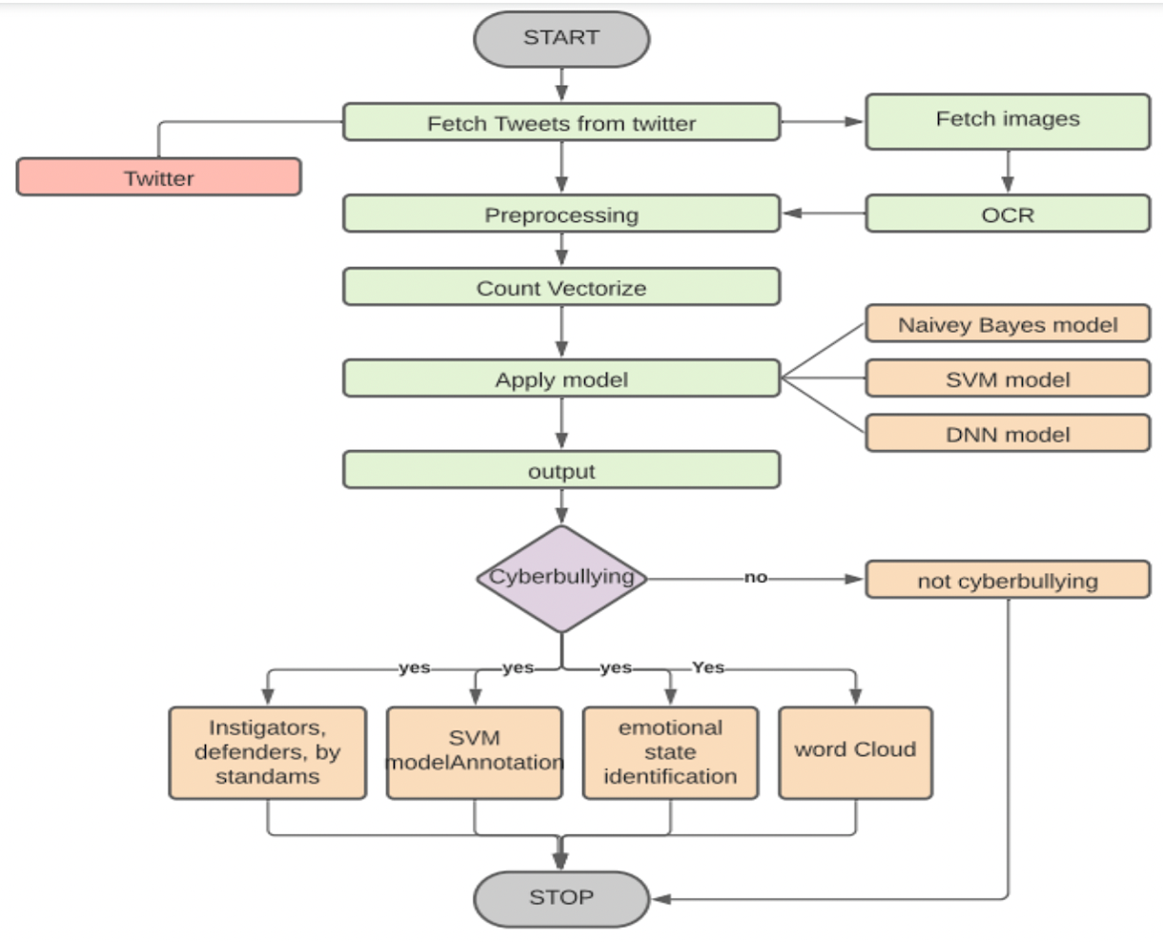
Flow Diagram of proposed architecture

Slide 11
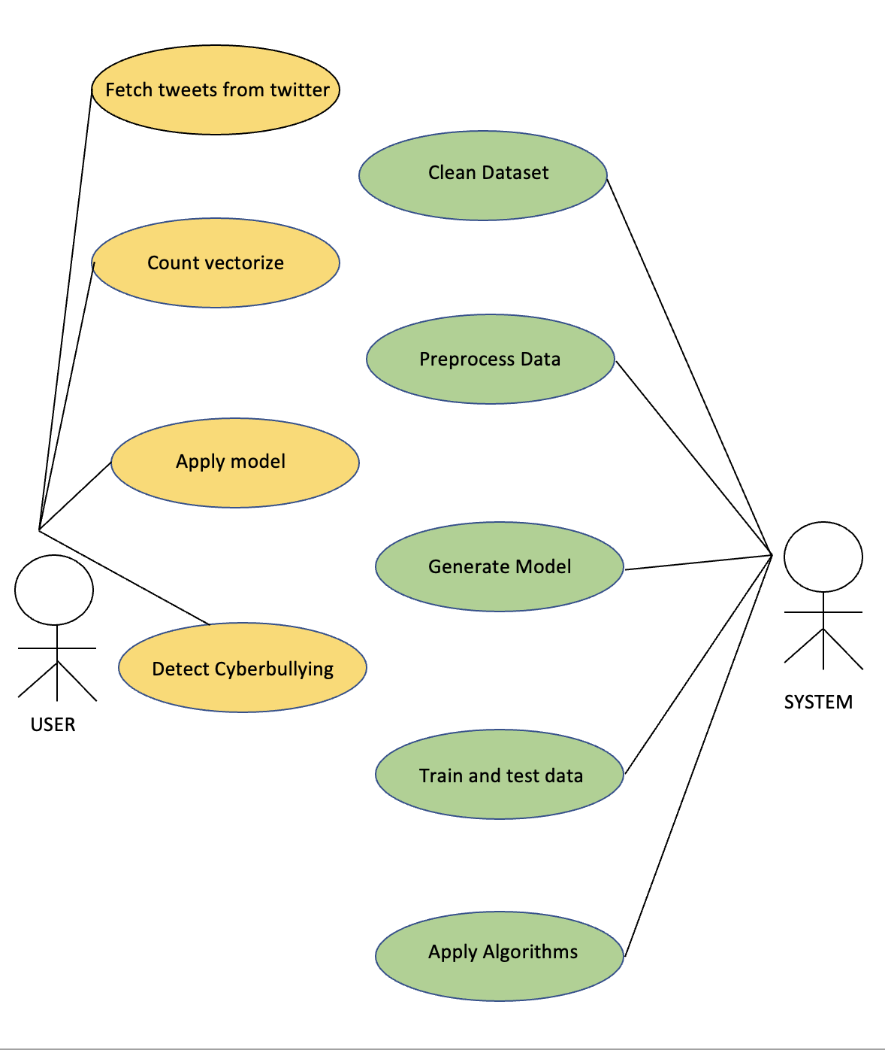
Interface of system

Slide 12
Outcome of Cyber bullying in Canada
Cyberbullying is an issue in schools, according to 80 percent of respondents.
Children are affected by cyberbullying, according to 94% of respondents.
Cyberbullying was a source of concern for 81 percent of respondents.
If cyberbullying occurred at school, 68 percent would take action.
Thirty percent were confident in their ability to recognise cyberbullying.
Only 23% were confidence in their ability to deal with cyberbullying.
Cyberbullying was considered as a topic that was just as significant as the other issues addressed in the teacher preparation programme by 47 percent of respondents.

Slide 13
Conclusion
Cyberbullying is the one of the major problem not only in India but all over the world. Through this project I proposed a cyberbullying detection model whereby several model like Naïve Bayes, SVM, DNN model is used. In addition to it , numerous methods of text classification based on Artificial Intelligence were investigated. This experiment trial test were conducted on a global Twitter dataset which I fetched from Kaggle. The experiment of this model results indicate that through this we achieved the best accuracy and accurate score with minute loss in our dataset, also their classification accuracy and loss are 96.82% and 0.1375, respectively.

Slide 14
Future Directions
-Future direction is properly based on or we can say working on cyberbully detection in various languages.
-Also to work on automatic detect from twitter without using the raw dataset.

Slide 15
REFERENCES
[1] D. Poeter. (2011) Study: A Quarter of Parents Say Their Child Involved in Cyberbullying. pcmag.com. [Online]. Available: http://www.pcmag.com/article2/0,2817,2388540,00.asp
[2] J. W. Patchin and S. Hinduja, “Bullies move Beyond the Schoolyard; a Preliminary Look at Cyberbullying,” Youth Violence and Juvenile Justice, vol. 4, no. 2, pp. 148–169,2006
[3] Anti Defamation League. (2011) Glossary of Cyberbullying Terms.adl.org.[Online].Available:http://www.adl.org/educati on/curriculum connections/cyberbullying /glossary.pdf
[4] N. E. Willard, Cyberbullying and Cyberthreats: Responding to the Challenge of Online Social Aggression, Threats, and Distress. Research Press, 2007.
[5] D. Maher, “Cyberbullying: an Ethnographic Case Study of one Australian Upper Primary School Class,” Youth Studies Australia, vol. 27, no. 4, pp. 50–57, 2008.
[6] D. Yin, Z. Xue, L. Hong, B. D. Davison, A. Kontostathis, and L. Edwards, “Detection of Harassment on Web 2.0,” in Proc. Content Analysis of Web 2.0 Workshop (CAW 2.0), Madrid, Spain, 2009.
[7] K. Dinakar, R. Reichart, and H. Lieberman, “Modeling the Detection of Textual Cyberbullying,” in Proc. IEEE International Fifth International AAAI Conference on Weblogs and Social Media (SWM’11), Barcelona, Spain, 2011.
[8] I. H. Witten and E. Frank, Data Mining: Practical Machine Learning Tools and Techniques, Second Edition. San Francisco, CA: Morgan Kauffman, 2005.
[9] R. Quinlan, C4.5: Programs for Machine Learning. San Mateo, CA: Morgan Kauffman, 1993.
[10] W. W. Cohen, “Fast Effective Rule Induction,” in Proc. Twelfth International Conference on Machine Learning (ICML’95), Tahoe City, CA, 1995, pp. 115–123.
[11] D. W. Aha and D. Kibler, “Instance-based Learning Algorithms,” Machine Learning, vol. 6, pp. 37–66, 1991.
[12] J. C. Platt, “Fast Training of Support Vector Machines using Sequential Minimal Optimization,” Advances in Kernel Methods, pp. 185–208, 1999. [Online]. Available: http://portal.acm.org/citation.cfm?id=299094.299105

